Slide 1
CAPSTONE PROJECT Medical Insurance Charge Prediction
20/04/2022

Slide 2
CONTENTS
Introduction
Dataset
Exploratory Data Analysis
Feature Engineering
Model Training
Results

Slide 3
INTRODUCTION
People are always confused about their medical insurance and don't know the cost of insurance at different ages and conditions
A Supervised Machine Learning Model was developed in this project to make predictions of the insurance cost they will have to pay

Slide 4
Dataset
This open dataset was taken from keggle and the table explains the columns of the dataset
Charges column represents the dependent variable of the dataset
Column Name | Description
age | Age of user
sex | Gender of user, Male/Female
bmi | Body Mass Index of user
smoker | If the user is smoker or not
region | Region where user lives
children | Number of children user have
charges | Actual Charge, user has to pay
https://www.kaggle.com/datasets/rajgupta2019/medical-insurance-dataset

Slide 5
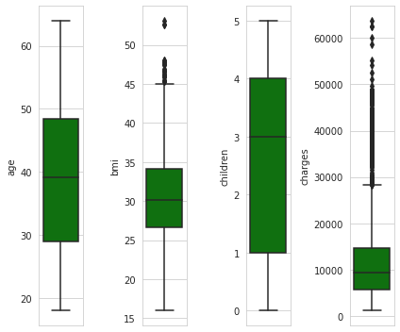
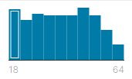
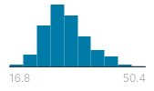


Exploratory Data Analysis
Data Distribution Analysis
Outlier Analysis
age | bmi | children
sex | smoker | region
Male – 58% Female - 42% |  | Northeast -30% Southeast -27% Other - 43%

Slide 6
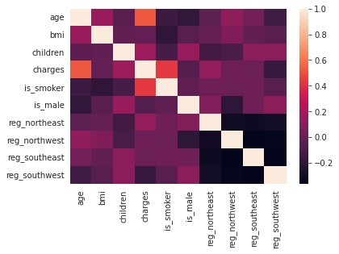
Exploratory Data Analysis
Correlation Analysis
Feature | Correlation
reg_southwest | -0.163218
is_male | -0.067385
bmi | -0.011718
reg_southeast | 0.011019
reg_northwest | 0.019978
reg_northeast | 0.139680
children | 0.163299
is_smoker | 0.432600
age | 0.520700

Slide 7
Feature Engineering
Categorical variables are one hot encoded/ binary encoded
Feature encoded | Encoded column names
Sex | is_male
Smoker | is_smoker
Feature encoded | Encoded column names
Region | reg_northeast
Smoker | reg_northwest
 | reg_southeast
 | reg_southwest

Slide 8
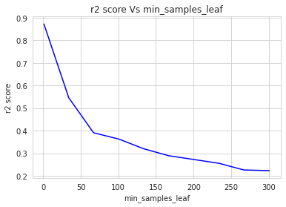
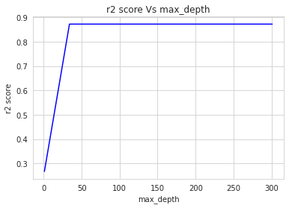
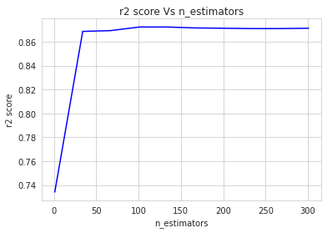
MODEL TRAINING
Random Forest regressor - Variation of r2_score

Slide 9
RESULTS
Model Name | Mean Square Error | Root Mean Square Error | R2 Score
Linear Regression | 7,124,544 | 2669.18 | 0.627561
XGB Regressor | 3,932,259 | 1982.99 | 0.794439
Random Forest R. | 2,284,328 | 1511.39 | 0.880586
Decision Tree R. | 3,429,477 | 1851.88 | 0.820723
Considering the above results, Random Forest Regressor is selected with - higher R2 score and
- minimum mean square error

Slide 10
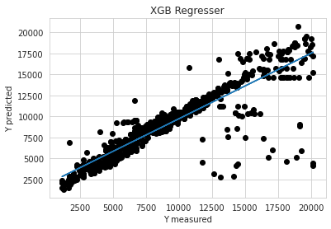
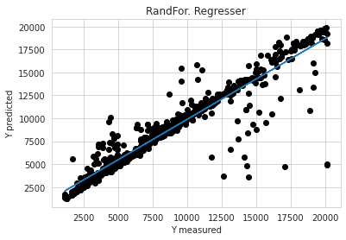
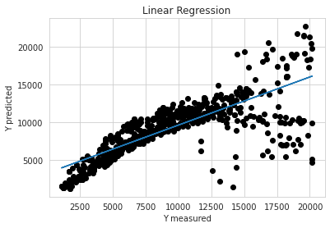
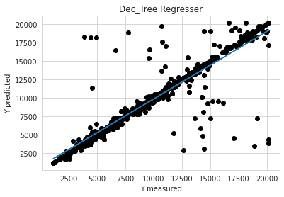
RESULTS
Cross Validation Figures

Slide 11
THANK YOU

